Slide 1

Online Chat Aplication
Mahmudul Islam
UG02-47-18-004
Course Code – 0318
Course Name - Software Engineering
Department of Computer Science and Engineering
State University of Bangladesh

Slide 2
Overview
Introduction
Development Tools
Modules
Features
Conclution

Slide 3
Introduction
This project is an example of chat application which is basically based on public chatting (message is broadcast to all connected users)
Communication is a mean for people to exchange messages. It has started since the beginning of human creation. The emergence of computer network and telecommunication technologies bears the same objective that is to allow people to communicate
The functionality of the chat application is to give the ability to chat or communicate with whoever is online on the application.

Slide 4
Development Tools
Language
Front-end : HTML, CSS
Back-end : PHP and JavaScript
Database : MySQL
Tools
XAMPP
VS Code

Slide 5
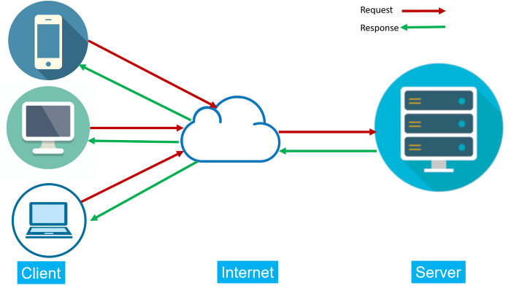
Server Diagram

Slide 6
Server Diagram
Chat system is a peer-to-peer system
where the users exchange text messages and files
between the system’s users
. The user of the system is defined as client-server.
Chat system is a distributed programming
which consist two distributed components, chat server and chat client.
Chat client supports for all communication
including requesting chat server location
information from a location server and display received chat messages.
Chat server will conduct chat session and manage all chat clients.
Basically chat client starts the chat session by requesting
the communication parameter (server name and port number).

Slide 7
Features:
Sign in/Sign up
Profile Picture
View active users
Follow Friends
User Profile
User Blog Share
Group Chat
Pdf Image Zip File Share
Block Option
Emoji Share
Logout
Admin Panel

Slide 8
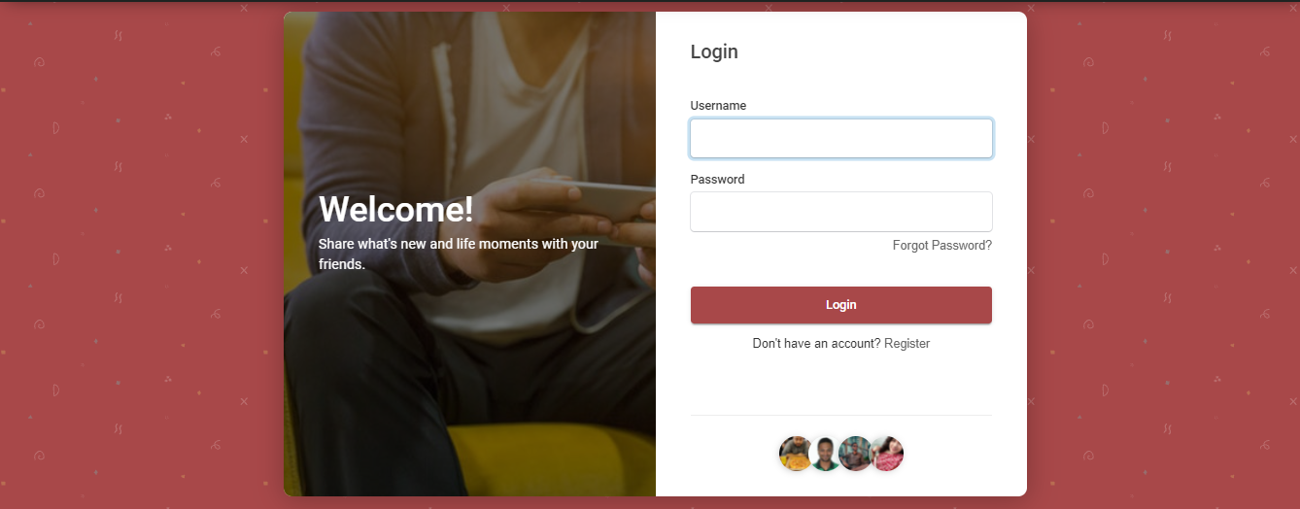
Login Page

Slide 9
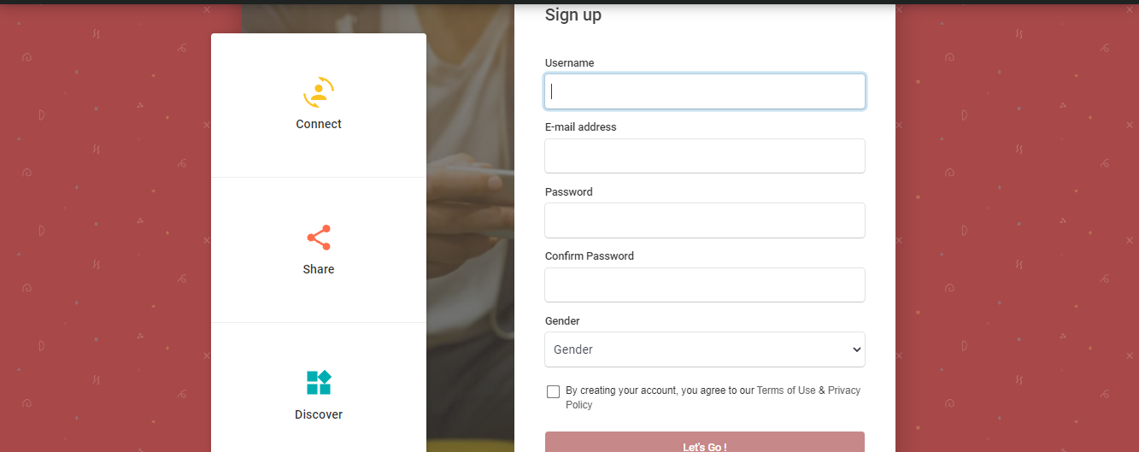
Sign Up Page

Slide 10
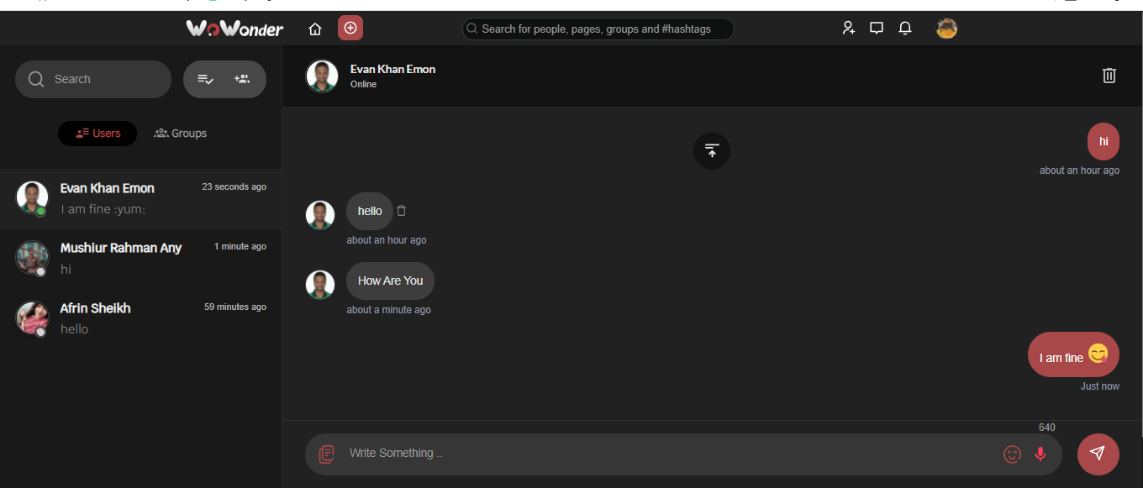
Chat Box Page

Slide 11
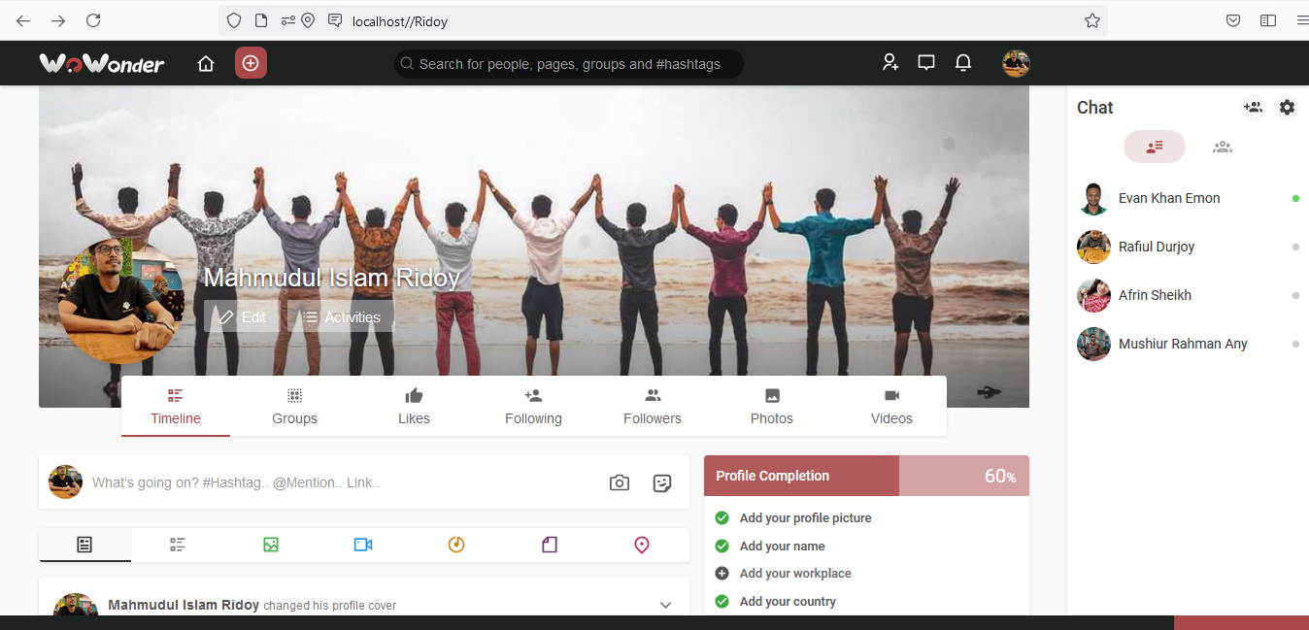
Profile Page

Slide 12
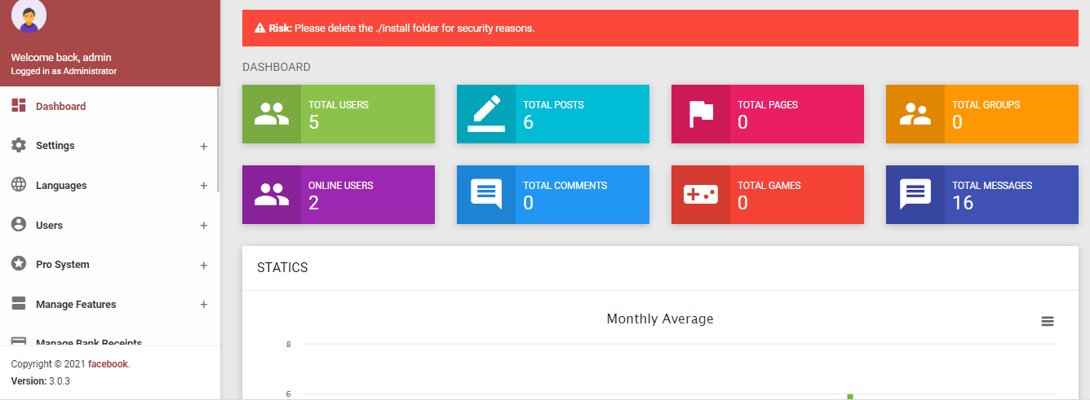
Admin Panel

Slide 13
Future Scope
File Transfer
Video Chat
Voice Call
Online Meeting
Chat Forum
Story Share

Slide 14
Conclution
There is always a room for improvements in any software package, however good and efficient it may be done. But the most important thing should be flexible to accept further modification Right now we are just dealing with text communication

Slide 15


